Slide 1
Soaps and Detergents

Slide 2
HİSTORY
The history of cleansing products can be broadly defined in two headings:
History of soaps
History of detergents

Slide 3
HİSTORY
The prehistoric people knew something about cleansing properties of water, such that it rinsed mud of their hands and body.
Some plants have leaves, which produce sapions and chemical compounds that give a soapy lather. These compounds were probably the first detergents that people used

Slide 4
HİSTORY
Ancient Egyptians and Greeks used soap like materials also for the treatment of different skin diseases as well as washing.
In modern times, the usage of soaps/detergents has become wide due to the importance of hygiene in reducing pathogenic microorganisms

Slide 5
HİSTORY
Detergents were originally called "synthetic" detergents, because they were put together chemically.
Soon after World War I, in Germany, soap industry began to develop synthetic detergents as a way to deal with the dual problems
of …………… ?

Slide 6
HİSTORY
competing with the food and feed industries for a limited supply of natural fats and oils,
poor cleaning performance in areas with hard waters

Slide 7
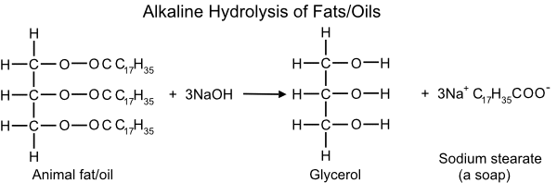
MAKING SOAPS
Soaps are formed by the alkaline hydrolysis (breaking up) of fats and oils by sodium or potassium hydroxide by boiling under reflux conditions:

Slide 8
Hydrolysis of esters such as fats/oil produces glycerol and fatty acids. Fats and oils are triglycerides meaning they are esters which contain 3 molecules of fatty acid condensed to 1 molecule of the trihydric alcohol, glycerol. So during hydrolysis, three molecules of soap are made per molecule of glycerol. (3:1 ratio of fatty acid:glycerol)
The hydrolysis is carried out using alkalis (NaOH or KOH) as catalyst and the fatty acids formed are changed into sodium or potassium salts (soaps)
The soaps are ionic and water-soluble.

Slide 9
The long covalent hydrocarbon chain that makes up the tail section of a soap structure can be represented in a number of ways, either in the shorthand notation shown below or as a bond-stick representation, shown at the bottom of the page. The charged carboxylate group represents the head section of the soap structure.

Slide 10
THE STRUCTURE OF SOAP
The long covalent hydrocarbon chain gives rise to the hydrophobic (water hating) and oil-soluble (non-polar) properties of the soap molecule (represented in yellow). The charged carboxylate group (represented in blue) is attracted to water molecules (hydrophilic). In this way, soaps are composed of a hydrophilic head and a hydrophobic tail:
In solution a soap molecule consists of a long non-polar hydrocarbon tail (e.g. C₁₇H₃₅-) and a polar head (-COO⁻).

Slide 11

covalent hydrocarbon chain
carboxylate head
O⁻
Na⁺
O
non-polar, oil-soluble, hydrophobic
polar, water-soluble, hydrophilic

Slide 12
EXAMPLES OF SOAPS
Sodium stearate (Chemical formula: C17H35COO-Na+)
Sodium palmitate (Chemical formula: C15H31COO-Na+)
Sodium oleate (Chemical formula: C17H33COO-Na+)

Slide 13
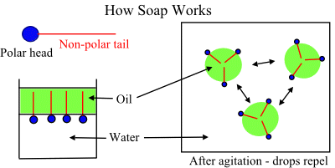
HOW A SOAP WORKS

Slide 14
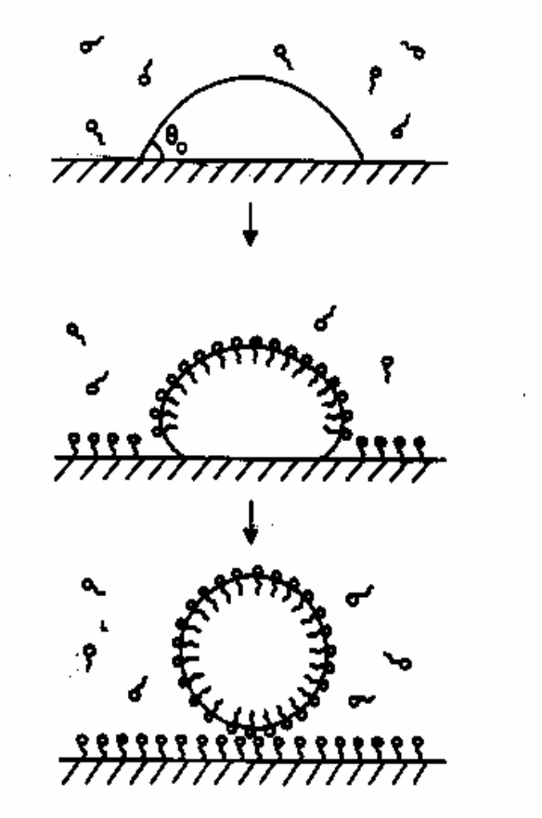
MECHANISM OF STAIN/DIRT REMOVAL
Roll-up mechanism
The hydrophobic tails ‘burrow’ into
the droplet of oil or grease.
The hydrophilic heads are left to
face the surrounding water.
This results in the formation of a
ball-like structure (a micelle).
The non-polar substances, such as
oil or grease, are held inside the ball
and suspended in water, to be
washed away.

Slide 15
ADVANTAGES & DISADVANTAGES OF SOAP
ADVANTAGES
Soaps are eco-friendly and bio degradable
DISADVANTAGES
Soaps are not suitable in the hard water.
They have weak cleansing properties than detergents.
When soap is used in hard water, a white solid precipitate we call scum forms. This is because charged calcium and magnesium ions present in the hard water react with soap to form an insoluble substance.

Slide 16
DETERGENTS
Detergents are the sodium salts of long chain benzene sulphuric acids.
Detergents are primarily surfactants, which could be produced easily from petrochemicals. Surfactants lower the surface tension of water, essentially making it 'wetter' so that it is less likely to stick to itself and more likely to interact with oil and grease.
Like soap, detergent molecules have a long chain of carbon and hydrogen atoms, but at the end of the molecule there is this group -SO3 - called sulphonate instead of the -COO - carboxylate group present in soap.
The calcium salt of a sulphonate is soluble in water unlike the calcium salts of the carboxylate.

Slide 17
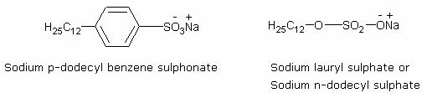
EXAMPLES OF DETERGENTS
Two basic examples of well-known detergents of the sulphonate group or the sulphate group are:

Slide 18
CLEANSING ACTION OF DETERGENTS
Synthetic detergents have the same type of molecular structure as soaps i.e. a tadpole like molecule having two parts at each end i.e., one large non-polar hydrocarbon group that is water repelling (hydrophobic) and one short ionic group usually containing the or group that is water attracting (hydrophilic).
Thus the cleansing action is exactly similar to that of soaps whereby the formation of micelles followed by emulsification occurs. However, synthetic detergents can lather well even in hard water.
This is because they are soluble sodium or potassium salts of sulphonic acid or alkyl hydrogen sulphate and similarly form soluble calcium or magnesium salts on reacting with the calcium ions or magnesium ions present in water. This is a major advantage of the cleansing property of detergents over soap.

Slide 19
ADVANTAGES OF DETERGENTS
Since detergents are the salts of strong acids they do not decompose in acidic medium. Thus detergents can effectively clean fabric even if the water is acidic.
Synthetic detergents are more soluble in water than soaps.
They have a stronger cleansing action than soaps.
As detergents are derived from petroleum they save on natural vegetable oils, which are important as essential cooking medium

Slide 20
DISADVANTAGES OF DETERGENTS
Many detergents are resistant to the action of biological agents and thus are not biodegradable. Their elimination from municipal wastewaters by the usual treatments is a problem.
They have a tendency to produce stable foams in rivers that extend over several hundred meters of the river water. This is due to the effects of surfactants used in their preparation. Thus they pose a danger to aquatic life.
They tend to inhibit oxidation of organic substances present in wastewaters because they form a sort of envelope around them.

Slide 21
DIFFERENCES BETWEEN SOAPS AND DETERGENTS
DETERGENTS
These are sodium salts of long chain hydrocarbons like alkyl sulphates or alkyl benzene sulphonates.
They are prepared from hydrocarbons of petroleum or coal.
These do not produce insoluble precipitates in hard water. They are effective in soft, hard or salt water.
cleansing action is by surfactants.
Some of are not biodegradable.
SOAPS
They are metal salts of long chain higher fatty acids.
prepared from vegetable oils and animal fats.
cannot be used effectively in hard water as they produce scum i.e., insoluble precipitates of Ca²⁺, Mg²⁺, Fe²⁺ etc.
cleansing action is not as strong as that of detergents.
biodegradable.

